Slide 1
Decision Trees
Louis-Philippe Préfontaine-Dastous, B.Eng., CBA, MBA, MMAI
Lead Instructor
General Assembly
Day 8

Slide 2
Small Recap from previous classes

Slide 3
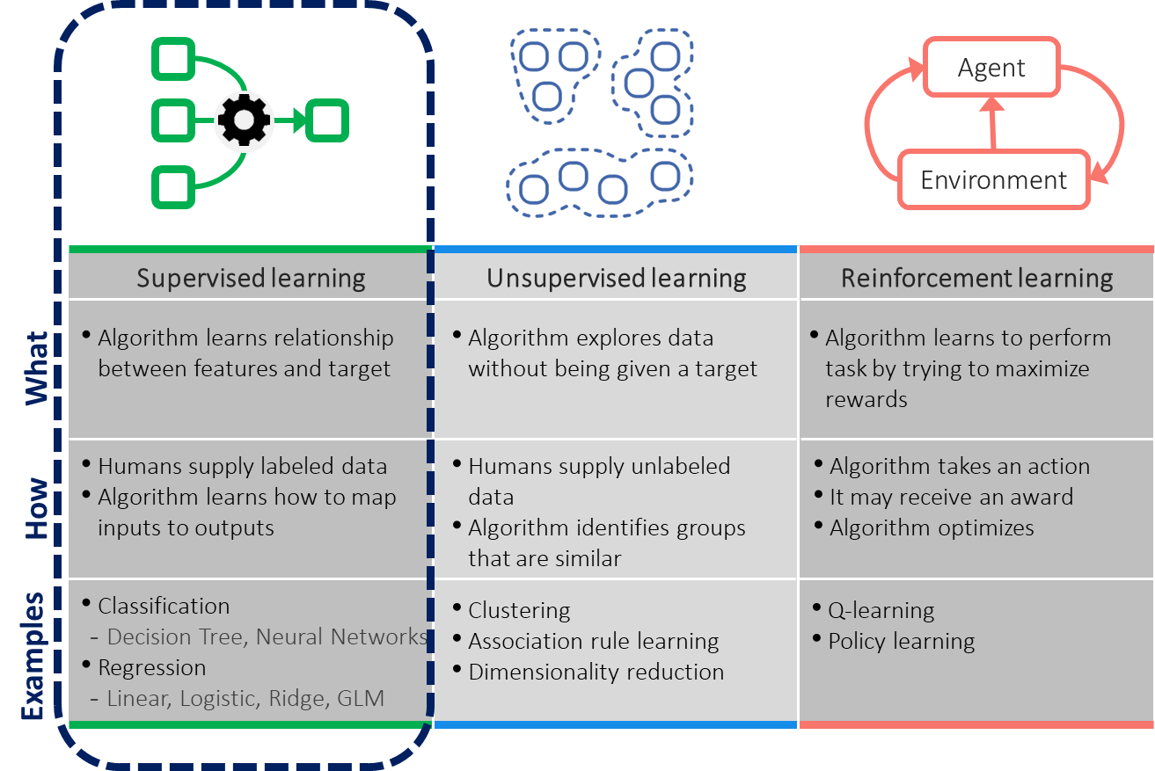
Major Types of ML Models

Slide 4
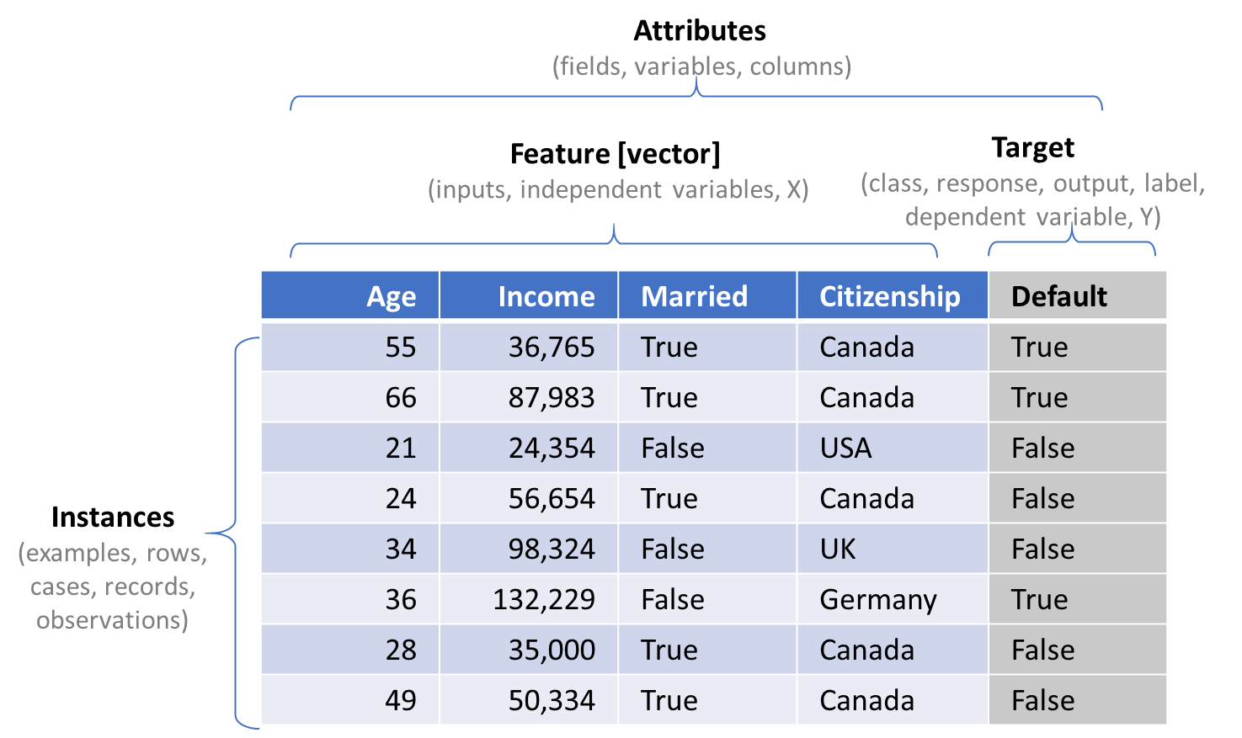
Machine Learning Terminology

Slide 5
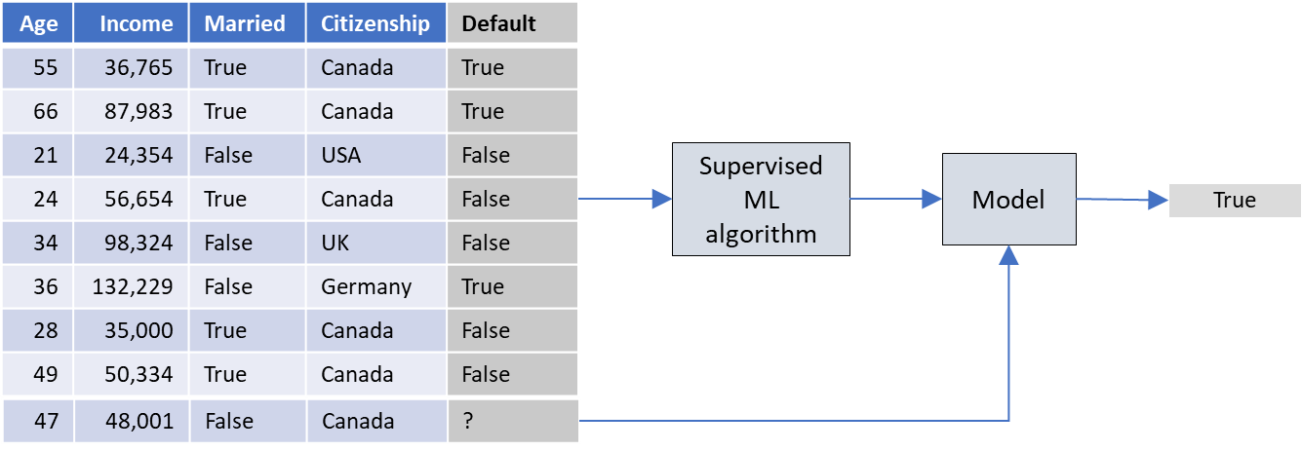
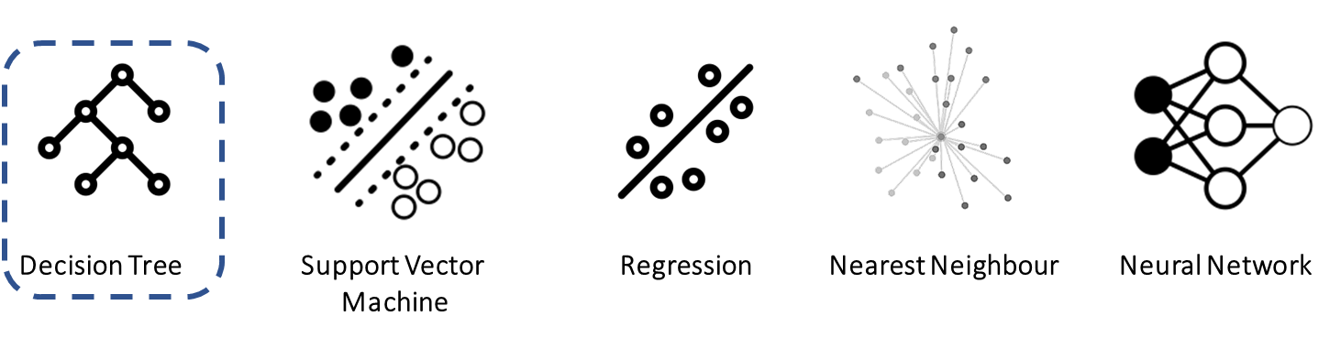
Supervised Learning

Slide 6
Course Outline
A little warm-up
Overview of Decision Tree with an example
How does it work
Attribute Selection Measure
Gain Ratio
Entropy
Short exercise on Python
Practices Projects

Slide 7
Course Objectives
Have fun while learning and learn a lot
By the end of the lesson, you should be able to use scikit-learn and start to familiarize yourself with Decision tree algorithm.

Slide 8
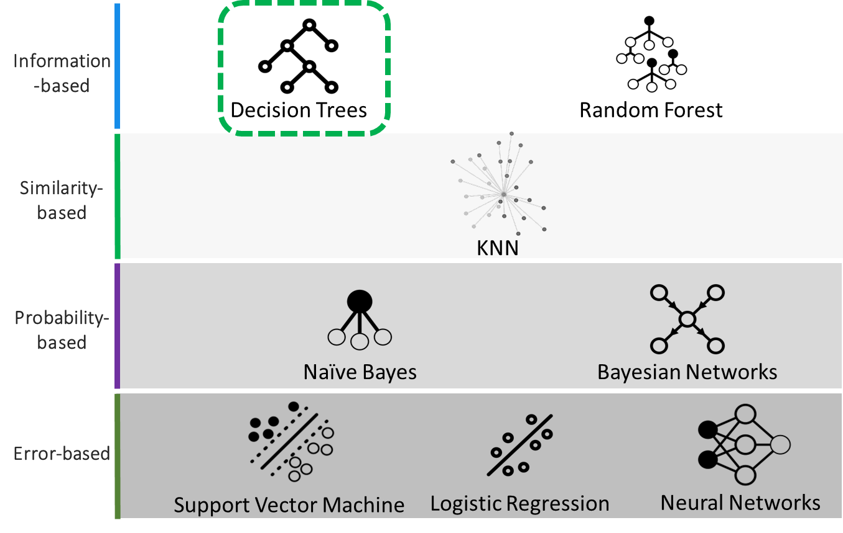
Popular Classification Algorithms

Slide 9

Warm-Up: Intuition for Decision Trees
"10 Questions":
Everyone grab a partner
First person thinks of an animal
Second person asks up to 10 "yes/no" questions in an effort to guess it
Guessing correctly counts as a win

Slide 10
Game: Results
Quick poll of the room:
How many got it right within 5 questions? 10 questions?
What was your question strategy?
Why was it effective/ineffective?

Slide 11
Game: Discussion
If you have an infinite number of questions...
One strategy: "Is it a Bear? Giraffe? Fish? etc."
Analogous to an overfitted decision tree
Accuracy would be high
If you have only one question:
One strategy: "Is it a mammal?"
Analogous to an underfitted decision tree
Accuracy would be low
Goal is to balance the two extremes
Enough branches to generalize
Not too many to overfit

Slide 12
Decision Trees
One of the most widely-used ML algorithms
Accuracy is usually high
Runtime is very low
Easy (ish?) to understand the results
The resulting model is a logical tree, called a decision tree
There are a few versions of the algorithm:
ID3: the original from 1986
C4.5 (aka J48): perhaps the best known and most used
Handles categorical and numeric data
Handles missing values
Uses pruning (error-based)
C5.0: Commercial version of C4.5

Slide 13
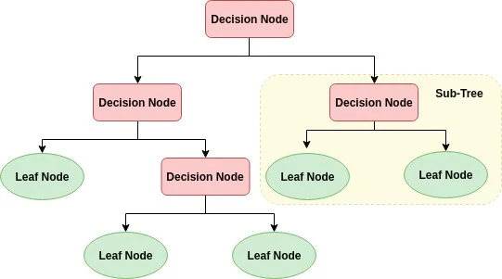
Decision Tree Flow Chart
Lexic & definitions

Slide 14
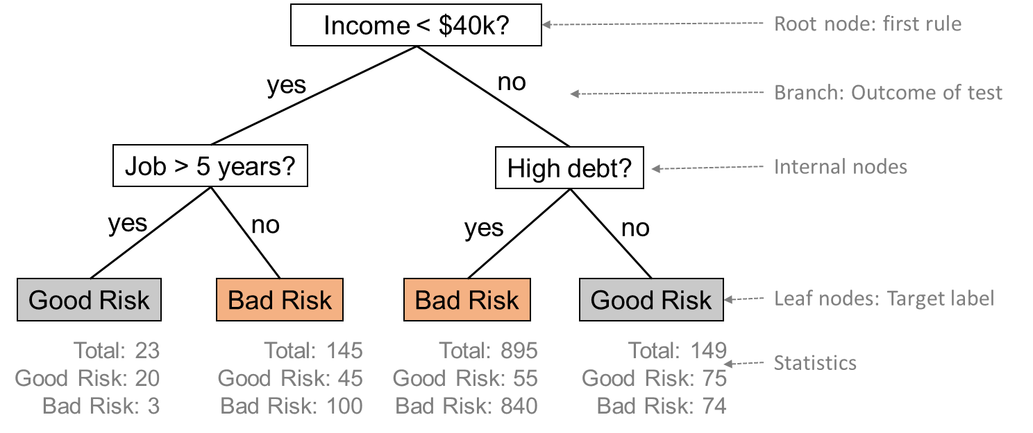
Overview of Decision Trees
Using training data, the algorithm "learns" a tree with rules
Example tree:

Slide 15
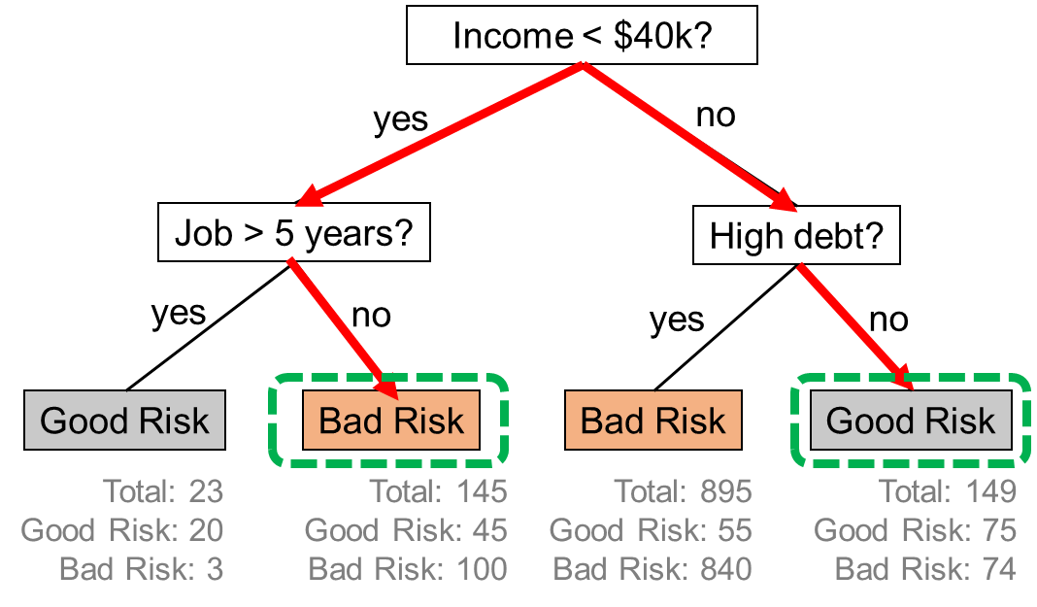
Using Decision Tree Models
Suppose a new customer applies for a loan
Age = 55 years; Job = 8 years; Debt = Low; and Income = $55K
Age = 29 years; Job = 4 years; Debt = High; and Income = $35K

Slide 16
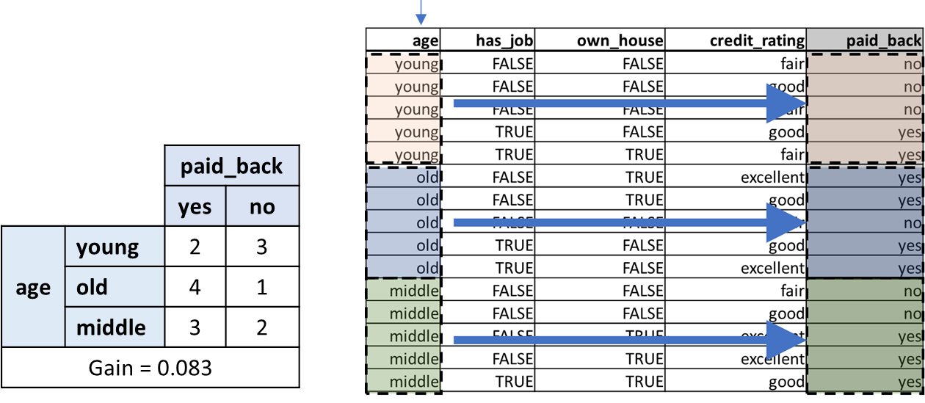
How Does it Work? (1/7)
ID3 Example: Loan default data
Algorithm wants
to create root node by splitting data on one feature
computes information gain metric on all features
First: age feature

Slide 17
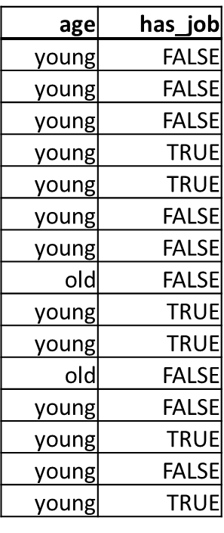
Wait, What Is Information Gain?
Information gain is a way to measure how much lower the entropy of the data will be, after splitting it by a particular feature
Entropy is a measure to determine how "mixed" an feature is
Feature mostly the same → low entropy
Feature mostly different → high entropy
Which has higher entropy?
How do we organize this?

Slide 18
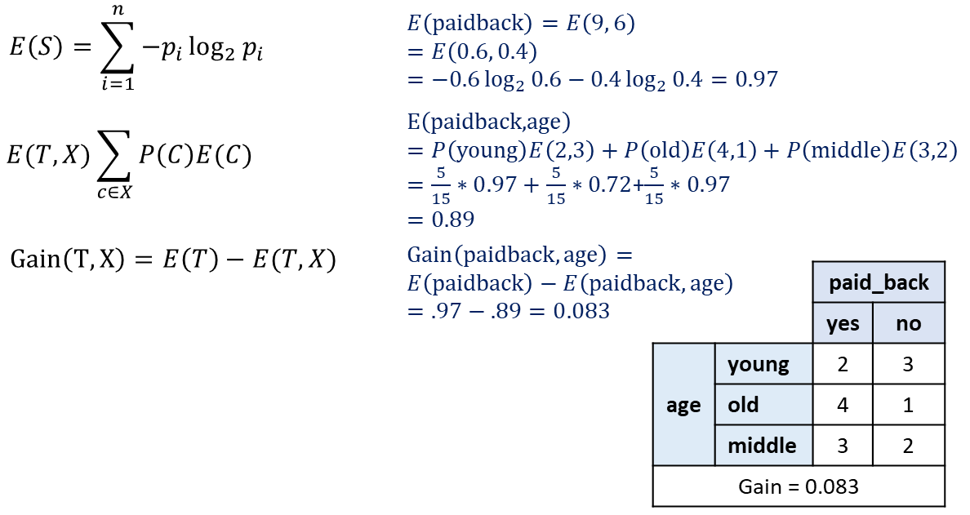
How to Calculate Information Gain?
1. Compute entropy of target
2. Compute entropy of target split by feature
3. Take difference

Slide 19
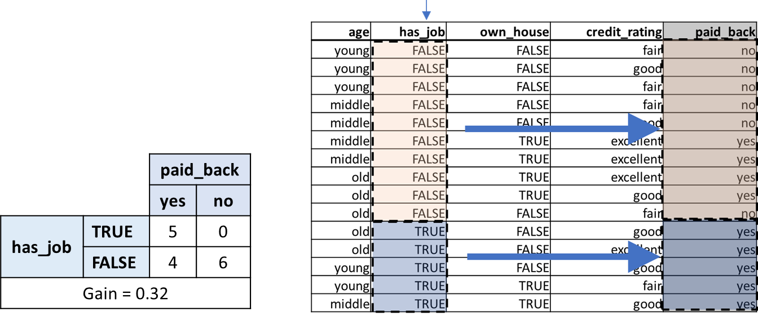
How Does it Work? (2/7)
Example: Loan default data
Second: has_job feature

Slide 20
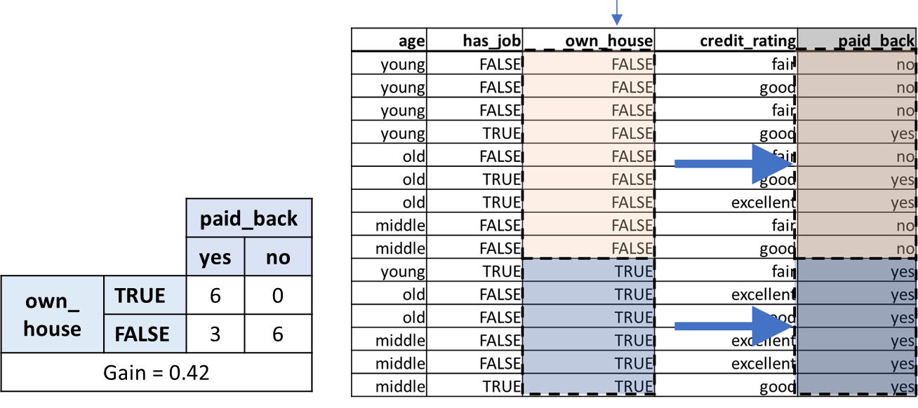
How Does it Work? (3/7)
Example: Loan default data
Third: own_house feature

Slide 21
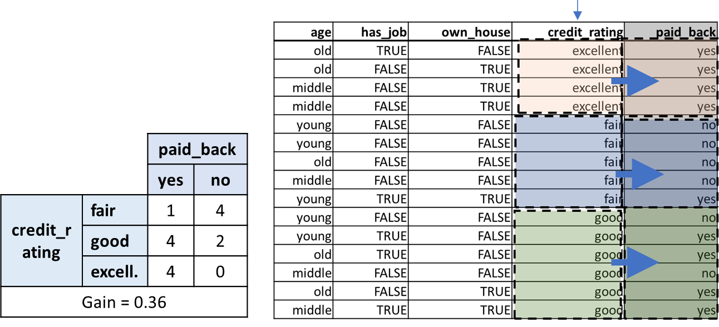
How Does it Work? (4/7)
Example: Loan default data
Finally: credit_rating feature

Slide 22
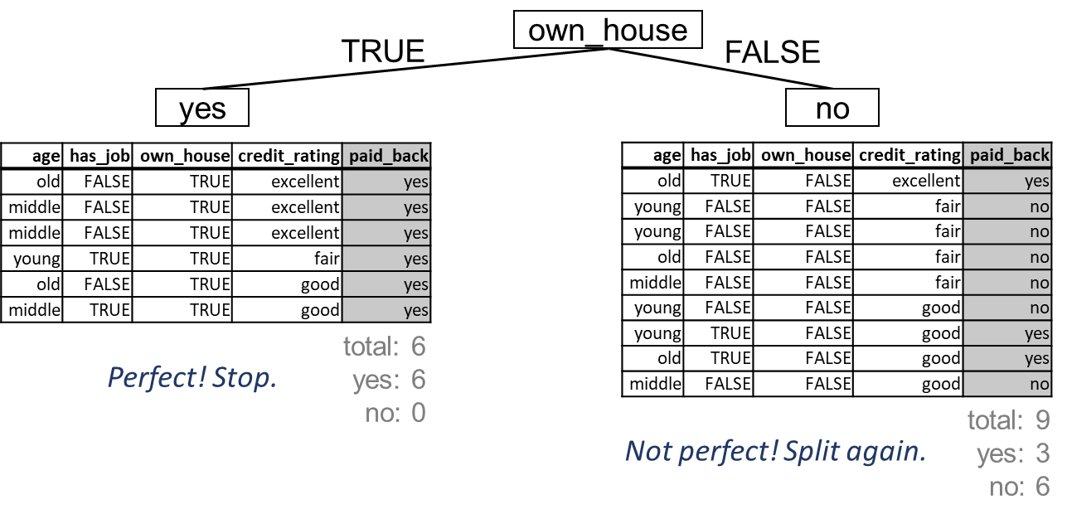
How Does it Work? (5/7)
Algorithm splits data on feature with highest gain (own_house)

Slide 23
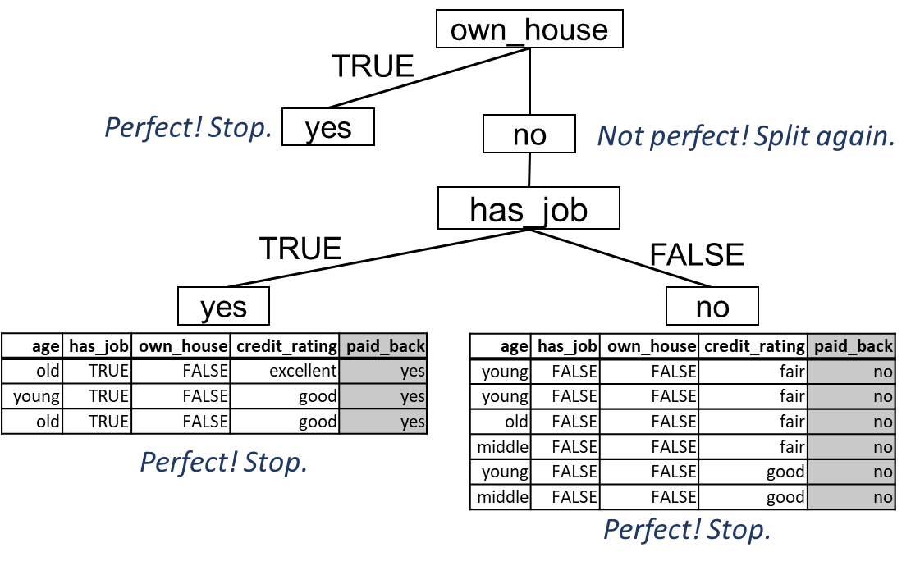
How Does it Work? (6/7)
Algorithm splits data on feature with highest gain (has_job)

Slide 24
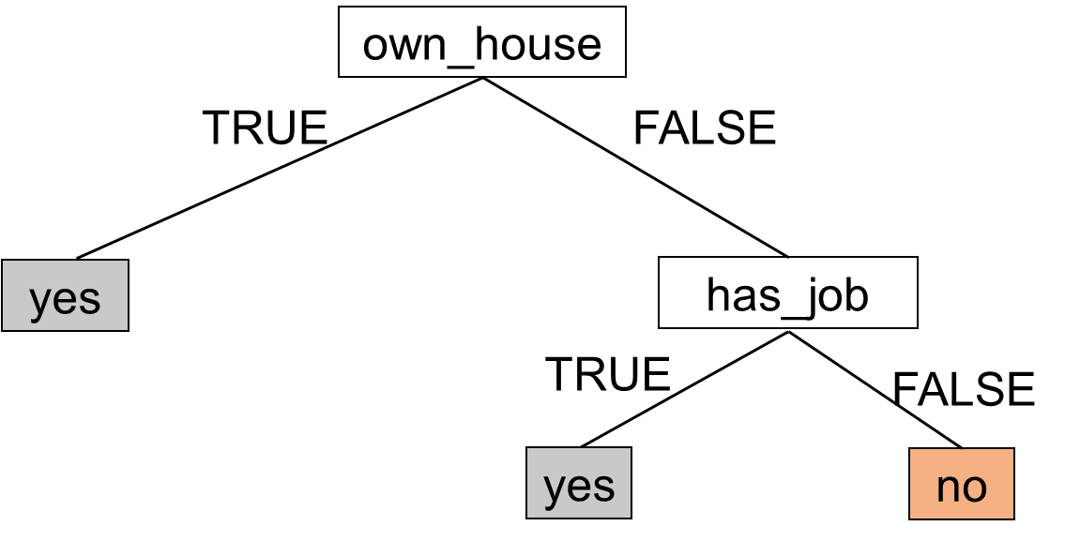
How Does it Work? (7/7)
Once algorithm is done splitting, final tree is output

Slide 25
General ID3 Algorithm
Tree is constructed starting at the root node
At root, select best feature for splitting
Brute force: all features are tried
Feature with highest value of impurity function (e.g., information gain) selected
Split data at that feature
After split, go to each new node, and select next best feature
Repeat
Conditions to stop splitting
All instances for a given node belong to the same target
There are no remaining features for further partitioning
There are no instances left
MAX_LEVEL parameter reached (set by human)

Slide 26
Short Demo with python
Decision_Tree_ID3.ipynb
Decision_Tree_scikit-learn.ipynb

Slide 27
Overfitting
A tree may over fit the training data
Symptoms
Good accuracy on training data but poor on test data
Causes
Tree too deep
Too many branches
Tree may reflect anomalies due to noise or outliers
Solutions
Pre-pruning: Halt tree construction early
Post-pruning: Remove branches or sub-trees from a "fully grown" tree.
This method is commonly used. C4.5 uses a statistical method to estimates the errors at each node for pruning.

Slide 28
Decision Trees: Pros and Cons
Pros:
Easy (ish?) to understand the model
Can use the model by hand to classify new data
Can handle continuous and discrete data
Can handle nonlinear data
Can handle variable interactions
Cons:
Doesn't handle small data very well
Structure is sensitive to small variations in the training data
Can overfit

Slide 29
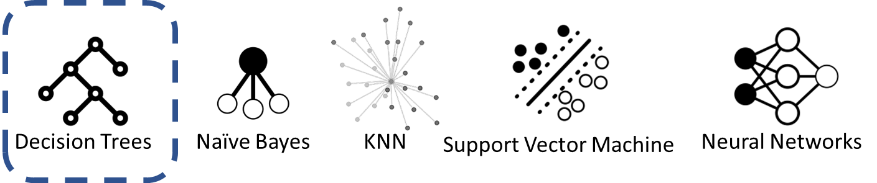
Summary
Classification: supervised ML algorithms to predict categorical variables
Which algorithm to use?
There's No Free Lunch

Slide 30
References
https://www.datacamp.com/community/tutorials/decision-tree-classification-python
https://heartbeat.fritz.ai/introduction-to-decision-tree-learning-cd604f85e236
https://scikit-learn.org/stable/modules/tree.html
https://www.geeksforgeeks.org/decision-tree-implementation-python/
https://www.python-course.eu/Decision_Trees.php
https://www.kdnuggets.com/2019/08/understanding-decision-trees-classification-python.html
https://dataaspirant.com/2017/01/30/how-decision-tree-algorithm-works/
https://dataaspirant.com/2017/02/01/decision-tree-algorithm-python-with-scikit-learn/
Inspired by Andrew Ng - The State of Artificial Intelligence

